Slide 1
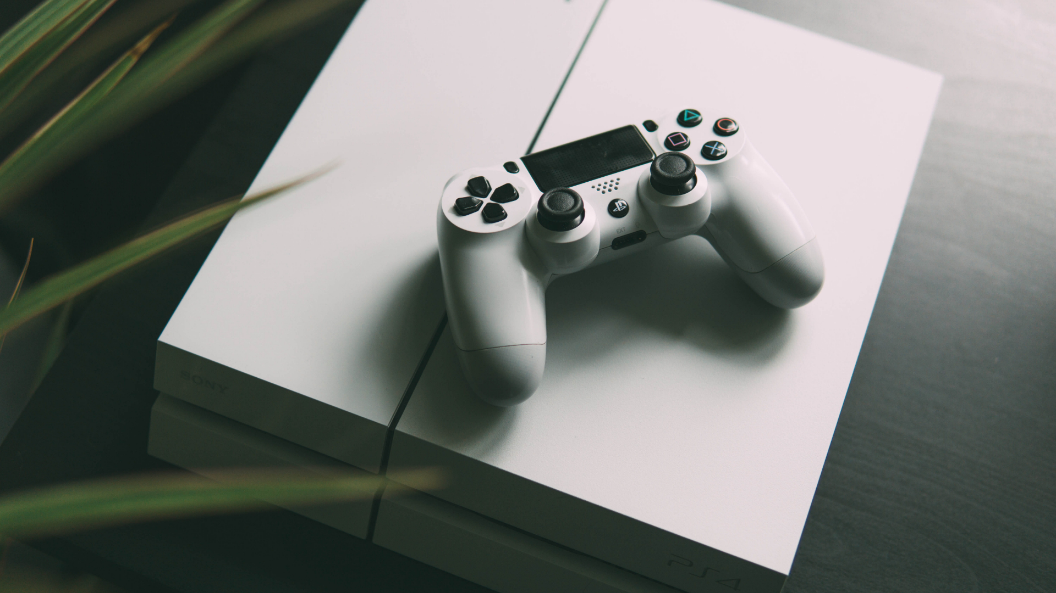
Platformer Game

Slide 2
Hello!
Md. Enzamam Ibne Bashar
Roll: 2201219
Tasfia Jannat Bushra
Roll: 2201229
Md. Ashraful Islam
Roll: 2201234
Md. Arifur Rahman
Roll: 2201204

Slide 3
Concept

Slide 4

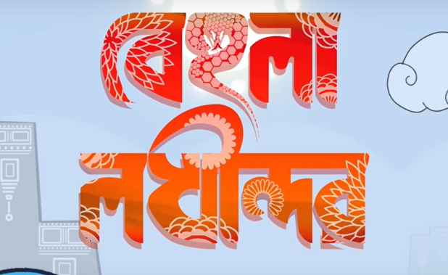
2D Platformer Game

Slide 5



Features
Story Telling Game
Single Player Mode
1
Score System
2
Audio and video effects
3
4

Slide 6

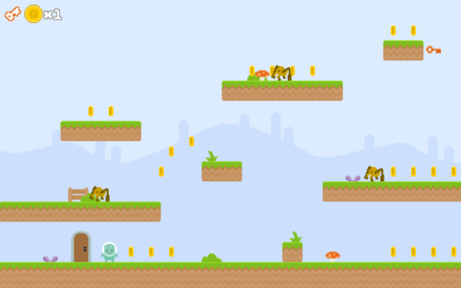


The Story

Slide 7
Desktop project
Place your screenshot here

Slide 8
Let’s See a Demo
Python
2D Platformer Game
Other Library
Pygame

Slide 9
Thanks!

